Slide 1

TypeScript
Unlocking the Power of TypeScript

Slide 2

About Me
Senior Software Engineer At Deutsche Telekom Digital Labs
JavaScript and TypeScript Enthusiast
Github / LinkedIn - VinayKrMittal

Slide 3
Agenda
• Introduction to TypeScript
• Why Use TypeScript
• Key Concepts in TypeScript
• Generics - Power of Flexible Code
• Deep Dive in Generics
• Conclusion

Slide 4
Introduction to TypeScript
• Superset of JavaScript
• TypeScript is built on top of JavaScript, the most widely used programming language for web development.
• TypeScript introduces optional static typing, allowing developers to specify types for variables, function parameters, and return values.

Slide 5
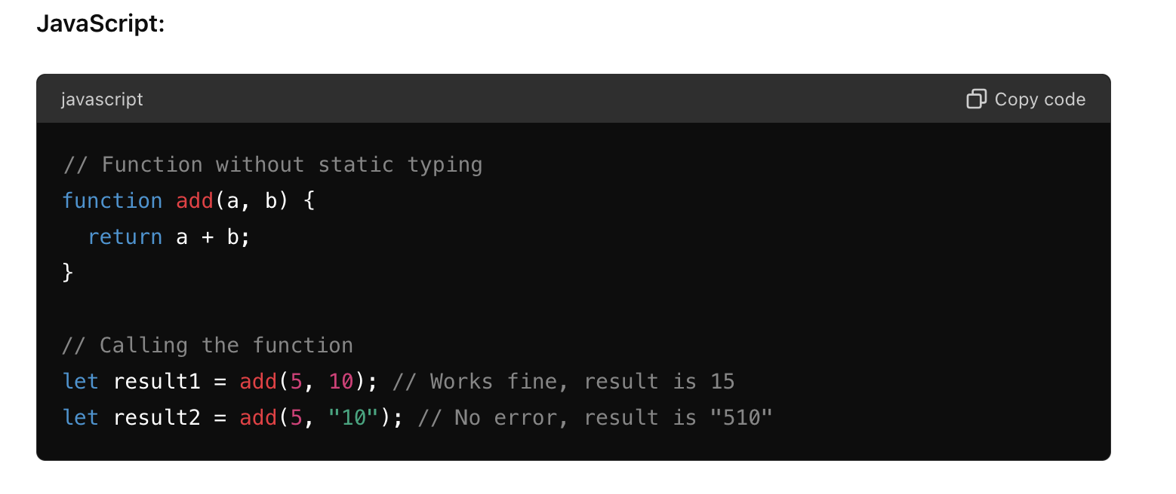
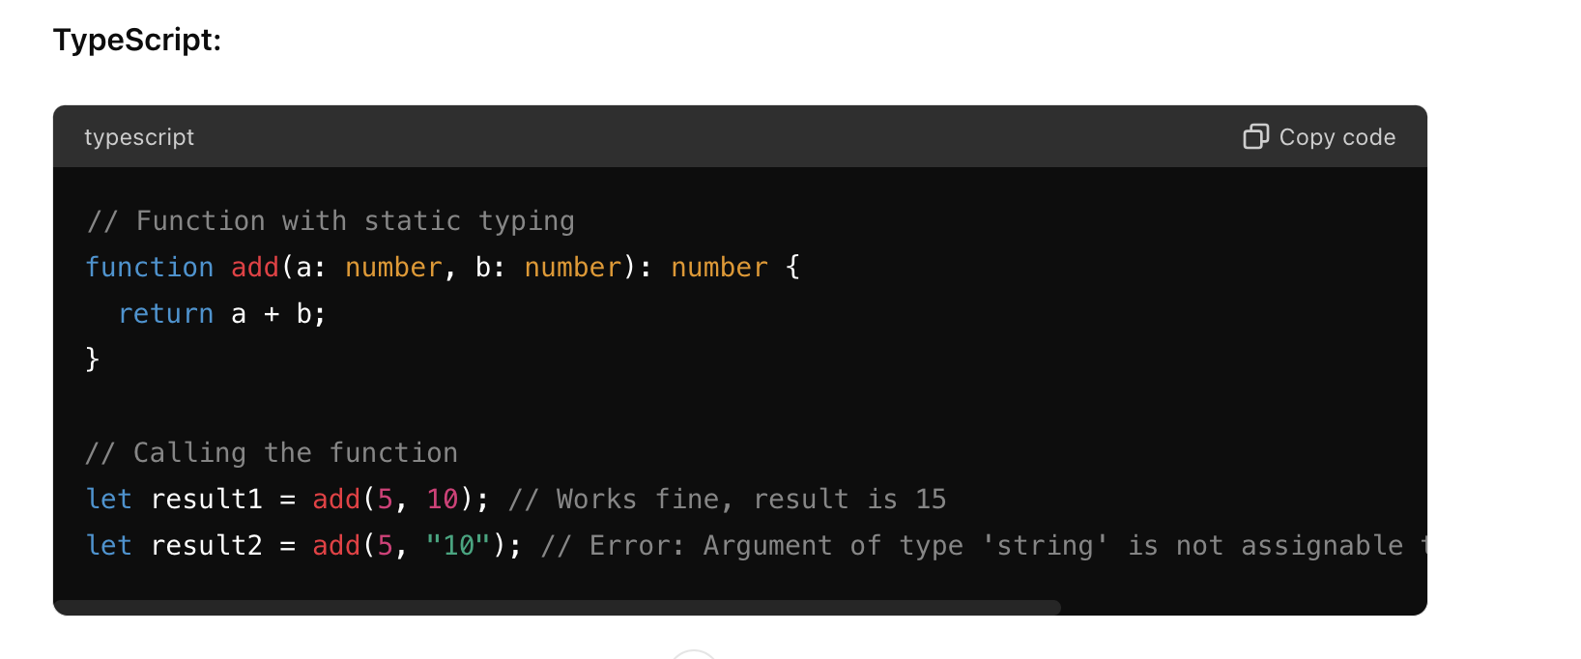
Introduction to TypeScript
Compile Time Error Handling

Slide 6
Why Use TypeScript
• Enhanced Code Quality
• Self-Documenting Code
• Increased Developer Productivity
• Active Community

Slide 7
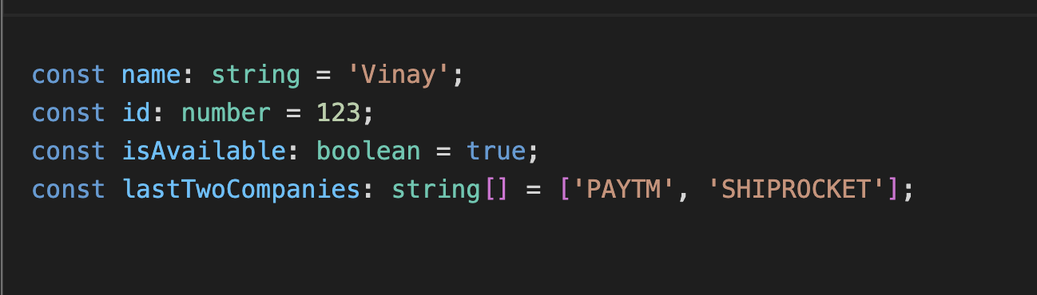
Key Concepts in TypeScript
The primitives (string, number, boolean ) and Arrays

Slide 8
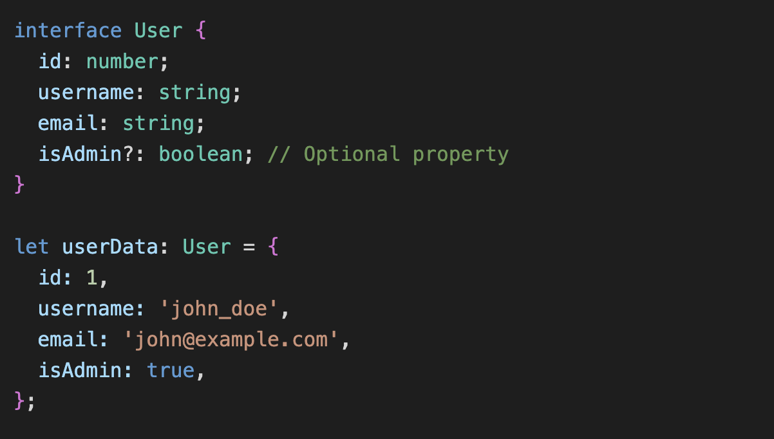
Key Concepts in TypeScript
Interfaces (Define Object Structure)

Slide 9
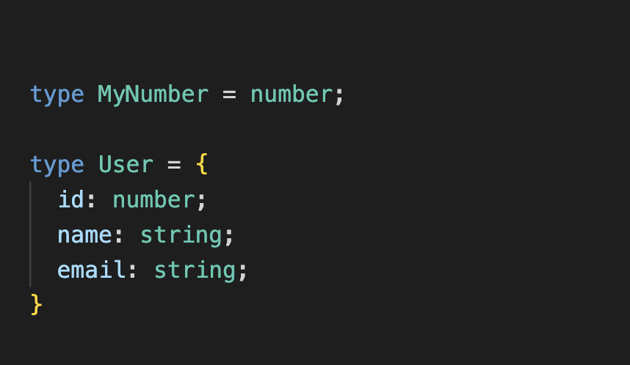
Type and type aliases
type is a keyword in TypeScript that we can use to define the shape of data. Type aliases in TypeScript mean “a name for any type.”

Slide 10

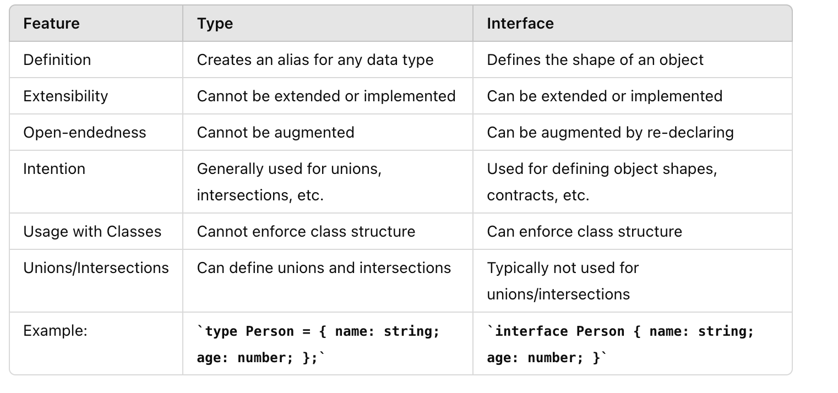
Type vs Interface

Slide 11
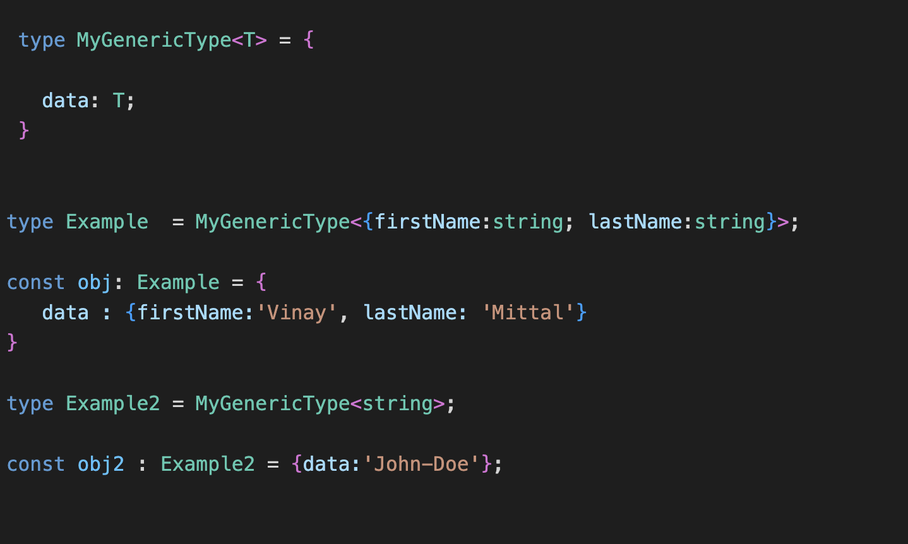
Generics – Power of Flexible Code
Generics enable writing flexible and type safe code without committing to a specific data type

Slide 12
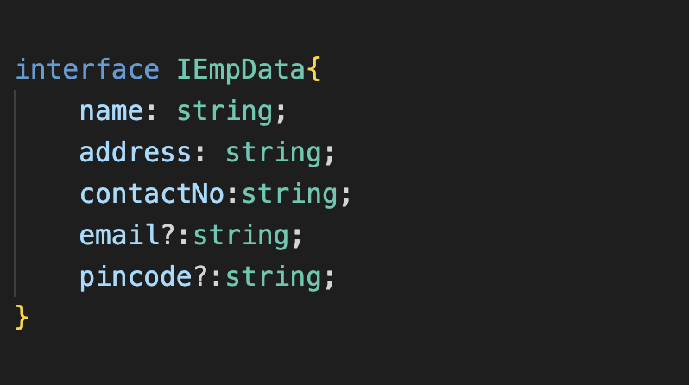

Make some properties required from an Interface
Write a Generic type to make properties required from an Interface.

Slide 13
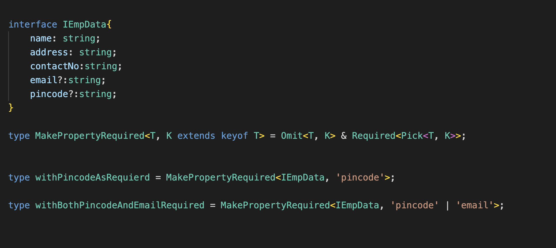
Solution 1 Omit optional property and again extends same property as required property

Slide 14

Solution 2 Make your own type helper to make property required without using any Utility Types (Omit, Required)

Slide 15
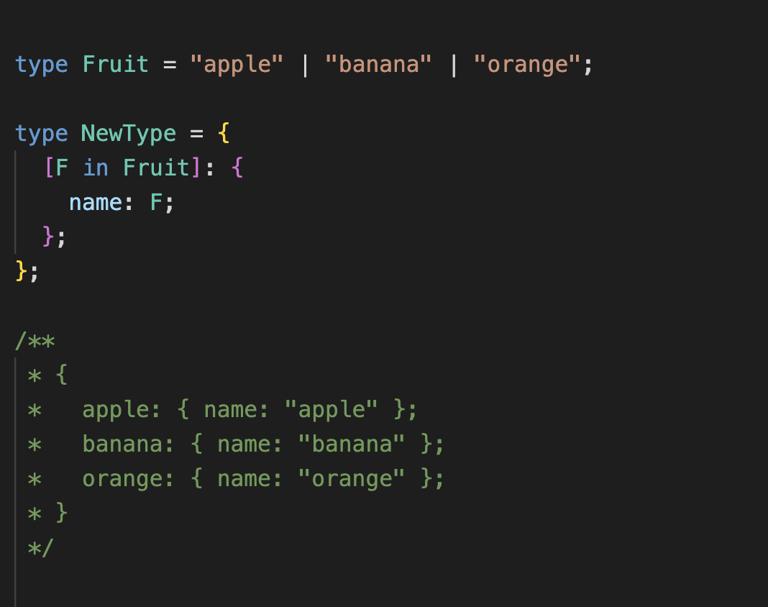
Let's Understand Mapped Type First Mapped types are a feature in TypeScript which allow you to map over a union of types to create a new type.

Slide 16
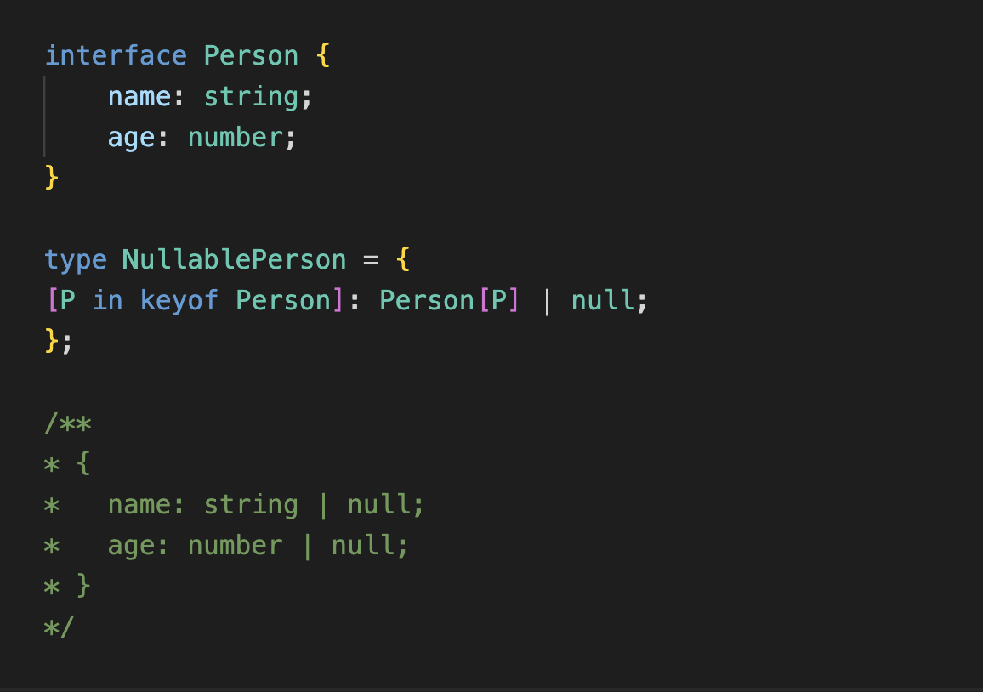
Mapped Type - keyof Using the keyof operator with mapped types gives you a smooth API to create object types from other object types..

Slide 17

Let's design a helper type to make properties required First we try to understand the how Required Utility type works and then we will design our custom helper type.

Slide 18
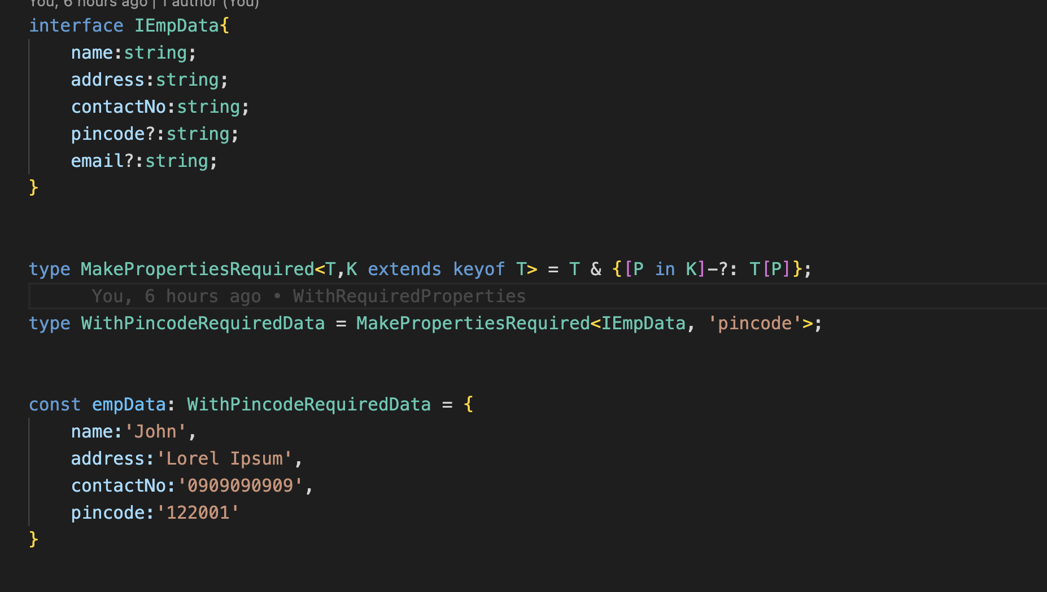
Required Properties Helper Type

Slide 19
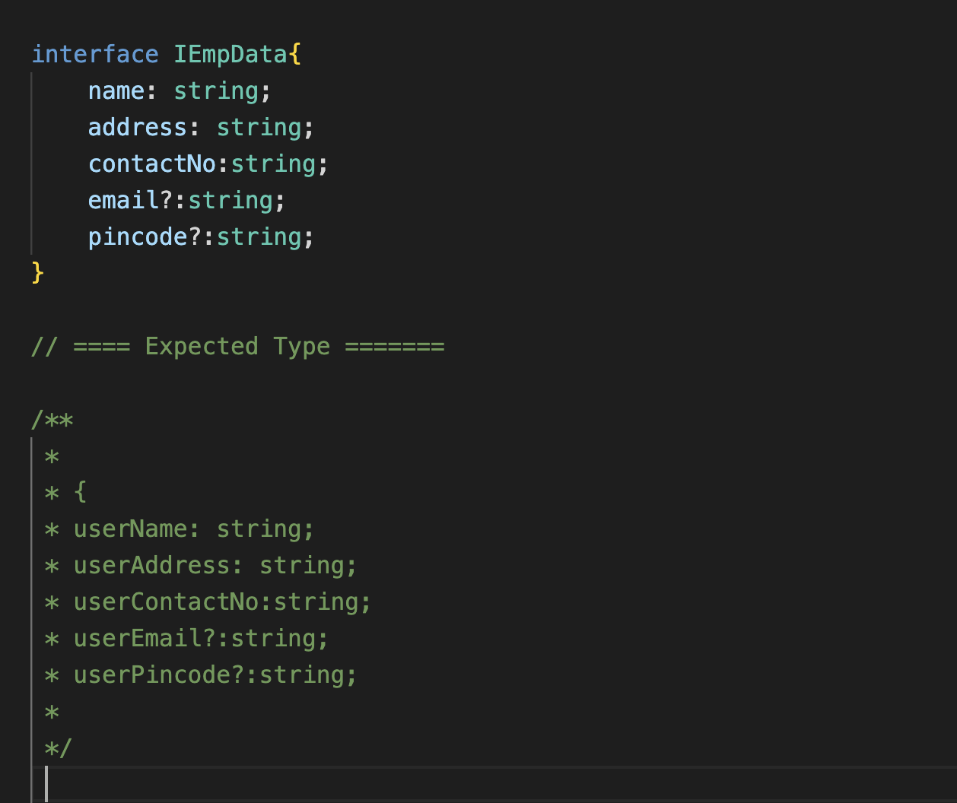
Let's make another helper type that capitalizes the first character of all property names and prefixes each one with the keyword "user"

Slide 20
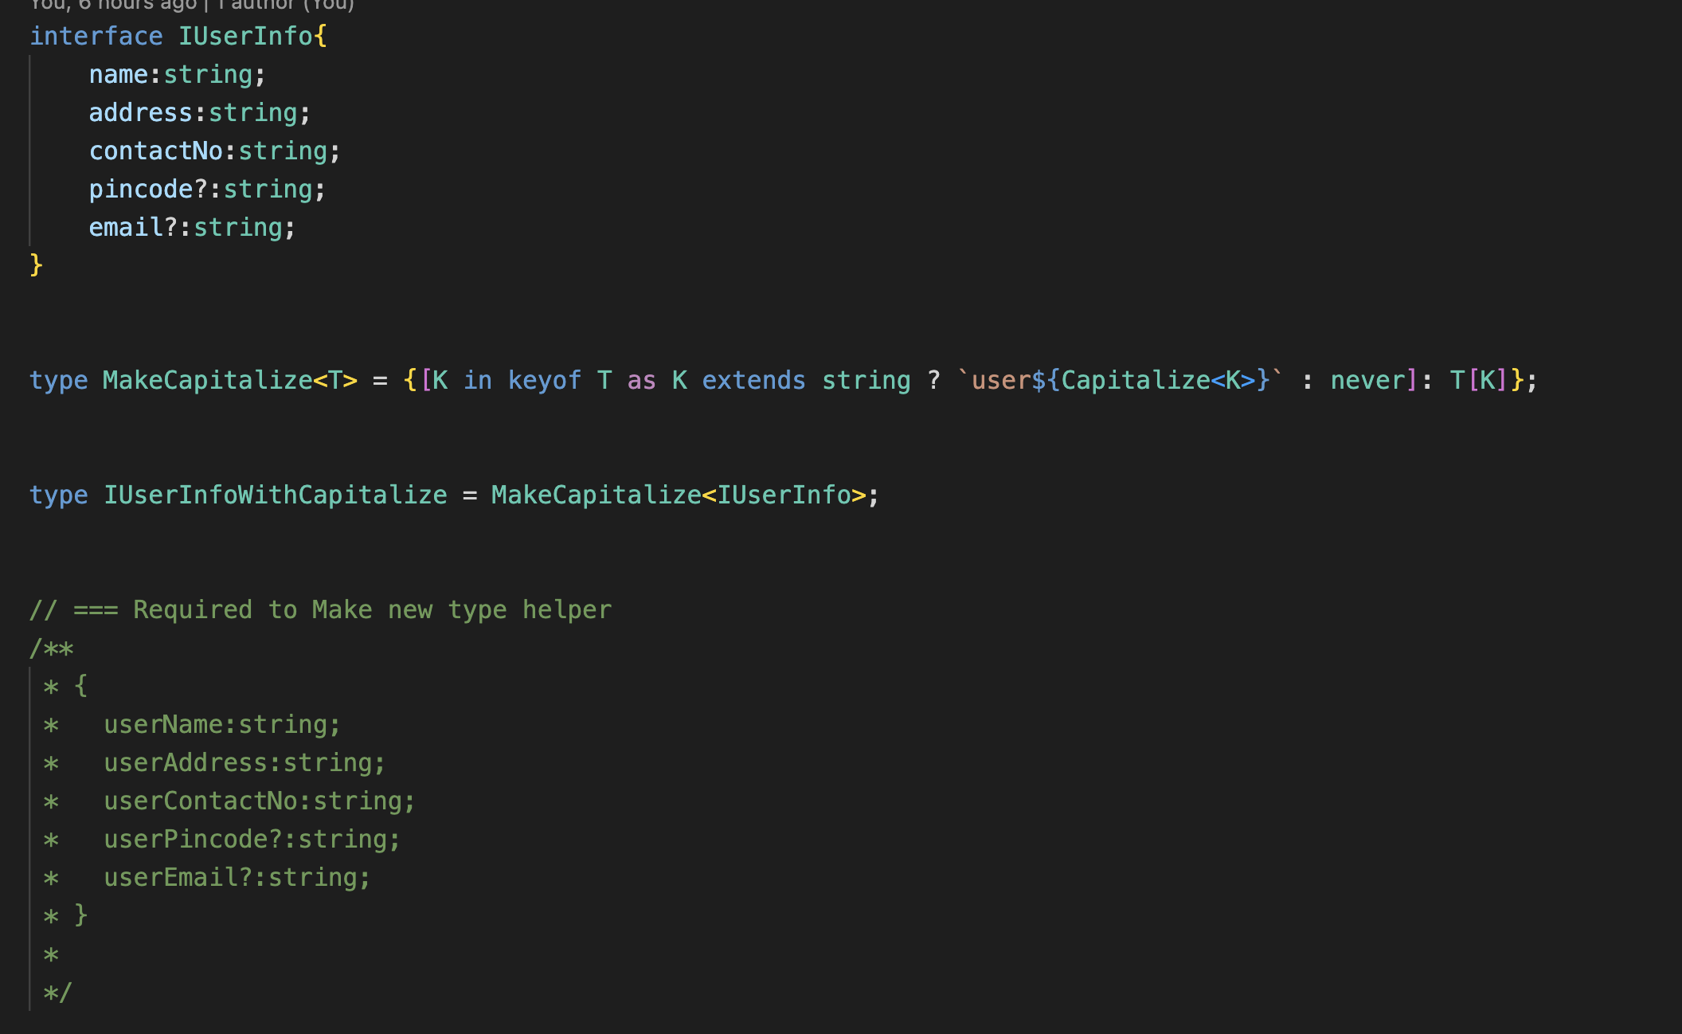
Capitalize Properties Helper Type

Slide 21
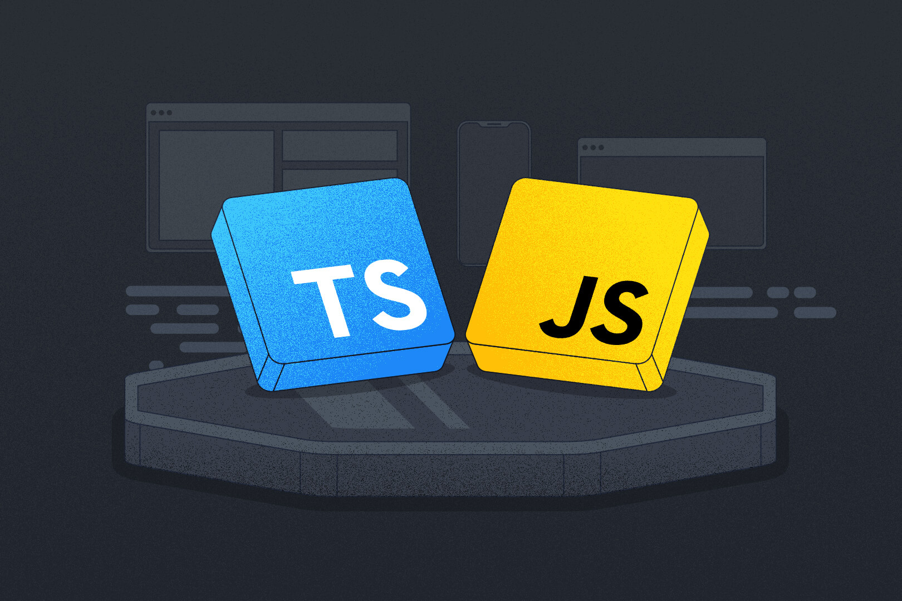
Conclusion
TypeScript provides the tools needed to improve your development workflow and produce higher-quality software.
TypeScript enhances JavaScript: Catches errors at compile time, improving developer productivity and code maintainability.
Leverage advanced types: Advanced type features, such as generics, mapped types, and conditional types, to write more expressive and reusable code.
Understand type constraints and defaults: Properly constrain and default generic types to balance type safety with flexibility in your code.

Slide 22

Thank You...

